Slide 1
Module 1:
Overview
Foundations of ML for Security
ML for Cybersecurity

Slide 2
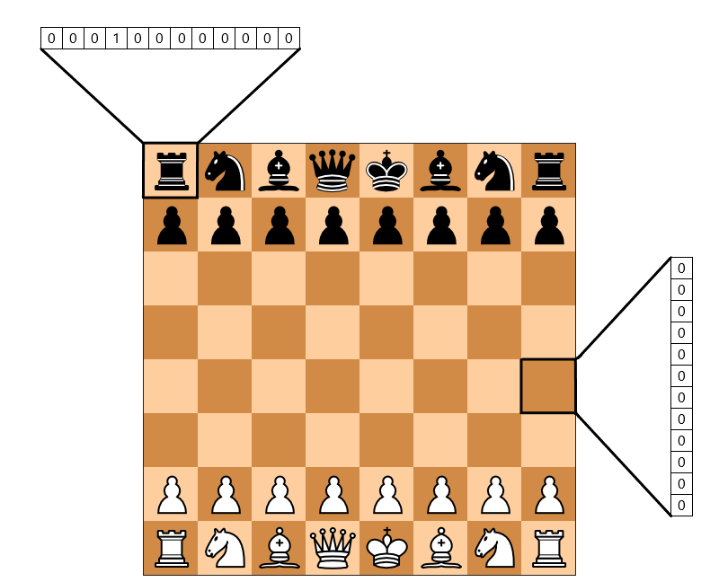



What is Machine Learning?
Automatic discovery of predictive rules from history

Slide 3
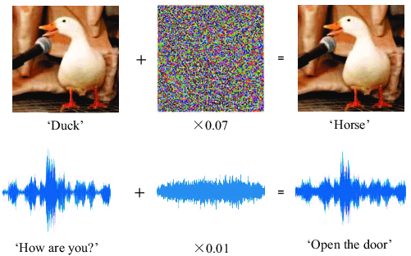
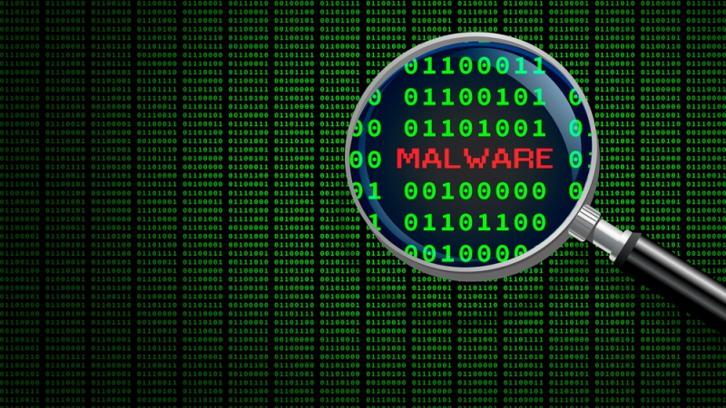
Machine Learning as a Tool for Cyber Security
Attacks – Learning – Defense
Machine learning for security
Security against attacks that exploit machine learning
Notes:
What’s the impact of ML on cybersecurity

Slide 4
Machine Learning Use Cases
For every file sent through the network, does it contain malware?
For every login attempt, has someone’s password been compromised?
For every email received, is it a phishing attempt?
For every request to your servers, is it a denial-of-service (DoS) attack?
…

Slide 5

Definition of Machine learning
Arthur Samuel, 1952:
Machine learning is the ability to learn without being explicitly programmed

Slide 6
A Brief History
1950: Alan Turing created the world-famous Turing Test — “The Imitation Game”
1952: Arthur Samuel coined the phrase “machine learning”, and create a computer program that improves checkers game
1956: The Dartmouth workshop started AI as a field (John McCarthy, Marvin Minsky, Nathaniel Rochester, Claude Shannon …)
1958: Frank Rosenblatt designed the first artificial neural network
1986: Geoffrey Hinton introduced backpropagation which enabled monumental leaps in ANNs
1995: Cortes and Vapnik “standardized” support vector machines
1997: Deep Blue beats a chess champion
1999: Computer-aided diagnosis catches more cancers (CAD Prototype at UChicago)
2009: Launch of ImageNet
2011: Watson competed on Jeopardy! and won against Ken Jennings and Brad Rutter
2012: AlexNet won the ImageNet competition, which led to the use of GPUs and Convolutional Neural Networks in machine learning
2016: AlphaGo defeated the human champion Lee Sedol in a best-of-five duel match
…
Now: AI dominates Silicon Valley and becomes pervasive
https://cloud.withgoogle.com/build/data-analytics/explore-history-machine-learning/
Notes:
Role of cybersecurity (adding one or two bullet points to the history)

Slide 7
Related Domains & Disciplines
Philosophy
Causality
Cybersecurity
Information Theory
Healthcare
Statistics
Machine Learning
Cyber-physical System
Algorithms
Neural-Informatics
Sciences
Optimization
Finance
…
Notes:
Adding a slide: Applications /industrial domains
Domains:
Cybersecurity
Industrial Players
News articles;

Slide 8
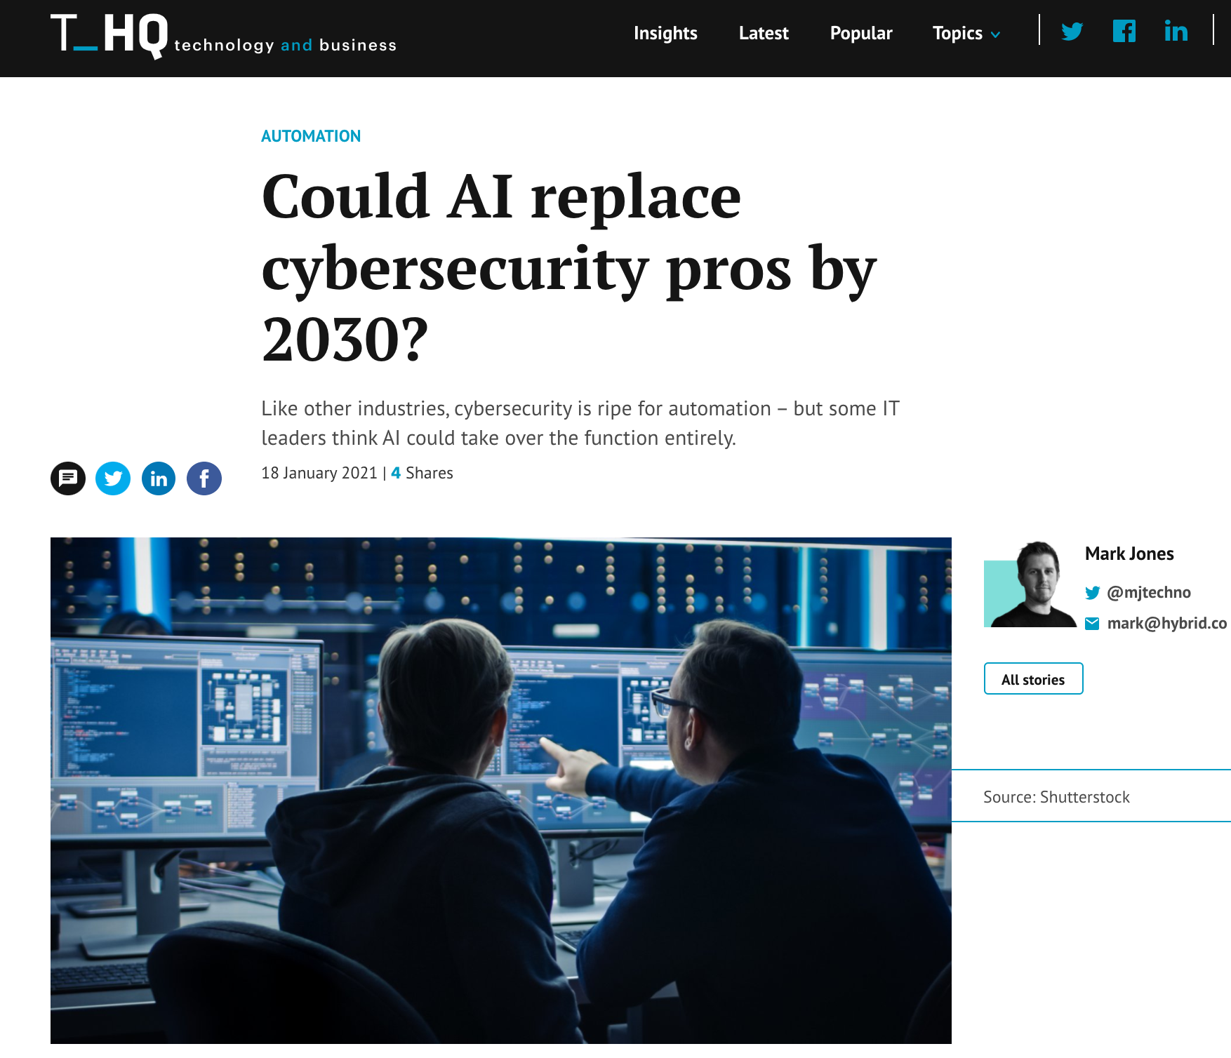

Slide 9
Module Overview

Slide 10
Adversaries
Ethics
Attacker’s goals
Attacker’s capabilities
Robustness of model/feature
Privacy
Fairness
Transparency
Modules 2 – 4
Module 4
Module 2
Module 1
Identify Goals & Collect Data
Data Representation
Modeling
Deployment
Pinpoint needs
Data acquisition
Data labeling
Data exploration
Data cleaning
Missing data
Feature selection
Consider fairness
Efficiency
Accuracy
Interpretability
Adversarial resistance
Performance
Evasion and attacks
Model drift
Impact on stakeholders
Module 3
Notes:
A module focused on machine learning fundamentals, with applications to security. Introduction to the data science pipeline, and teach fundamental building blocks, from data ingestion and feature engineering to machine learning model selection.
Modeling; Representation; Environment; Constraints (?)

Slide 11

Foundations of “Modeling”
Machine learning pipeline
The statistical learning framework
Generative & discriminative modeling
Basic supervised learning models
Logistic regression
Naïve Bayes
Neural nets
Unsupervised learning
Dimensionality reduction
Clustering
Credit @NOELIAGOROD
Notes:
CNN
Application in Cybersecurity (as running, concrete examples)
Coloring, animation, highlighting (hand drawing)

Slide 12
Learning Objective

Slide 13
After participating in this module, you will
Understand the basic concepts underlying the practice of ML
Identify practical scenarios…
where ML can play a key role in cybersecurity
Analyze ML models using statistical tools …
and choose the best model for a use case!
Implement for cybersecurity applications a variety of ML models
E.g., from classical approaches such as logistic regression to representation learning methods such as convolutional neural networks
Notes:
Measurable outcomes
Actionable
----
Some recommendations around reframing the learning objectives as measurable outcomes:
a. Describe the basic ideas and concepts underlying the practice of machine learning
b. Identify where and how machine learning can play a key role in cybersecurity
c. Analyze machine-learning models using statistical tools and choose the best model for a use case
d. Implement for cybersecurity applications a variety of machine learning models, from classical models such as logistic regression to deep learning techniques such as convolutional neural networks

Slide 14
Rest of this module
Pre-recorded video lectures
The statistical learning framework
Supervised learning
Neural networks and deep learning
Unsupervised learning
A primer to ML in python
Exercises and extended reading materials
In-class discussions
Notes:
Might consider reiterating here how the videos, notebooks, and live sessions fit together in the module
1. Order? Watching all the videos, then doing the notebooks? Or doing them in the order provided?
2. How to use notebooks? Just read through them? Encourage them to experiment, etc.?
Exercises and extended reading materials
ML models under the hood (demos in Jupyter notebooks)
Extended reading materials on ML models covered in the video
In-class discussions
Breakout room session 1: Comparison of ML models introduced in this module
Breakout room session 2: Case study and model selection

